Slide 1
Lake browning (DOC) and fish feeding ecology
Course: BIS15L
By: Miranda Mustafa, Kenta Hsu, Marko Danchak

Slide 2
Background
DOC or Dissolved Organic Carbon is when decaying plants or organisms causes the water to brown overtime. This makes it so the sunlight cannot penetrate through the water as easily and thus controls nutrition availability and water temperature. DOC reducing light penetration causes primary production is suppressed and reliance on algae-based food sources shifts to bacteria-based food sources

Slide 3
Data Source
-Charette et al. 2024 freshwater fish dataset - -3,430 fish records, 78 lakes, 6 species, 6 regions
- Variables: DOC, isotopes, trophic position, pelagic diet proportion, fish length

Slide 4
Research Questions
Question 1 : DOC vs trophic position Question 2: DOC vs pelagic diet proportion
Question 3: Species/region differences in DOC relationships

Slide 5
Workflow
- Import and clean two CSV files
- Join fish and baseline data by lake
- Create analysis dataset and DOC categories
- Check missingness and build summaries

Slide 6
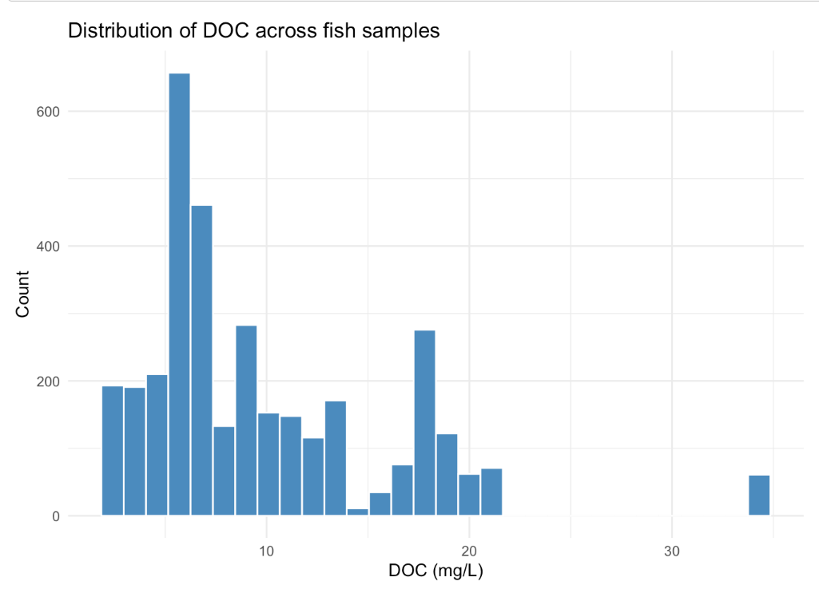
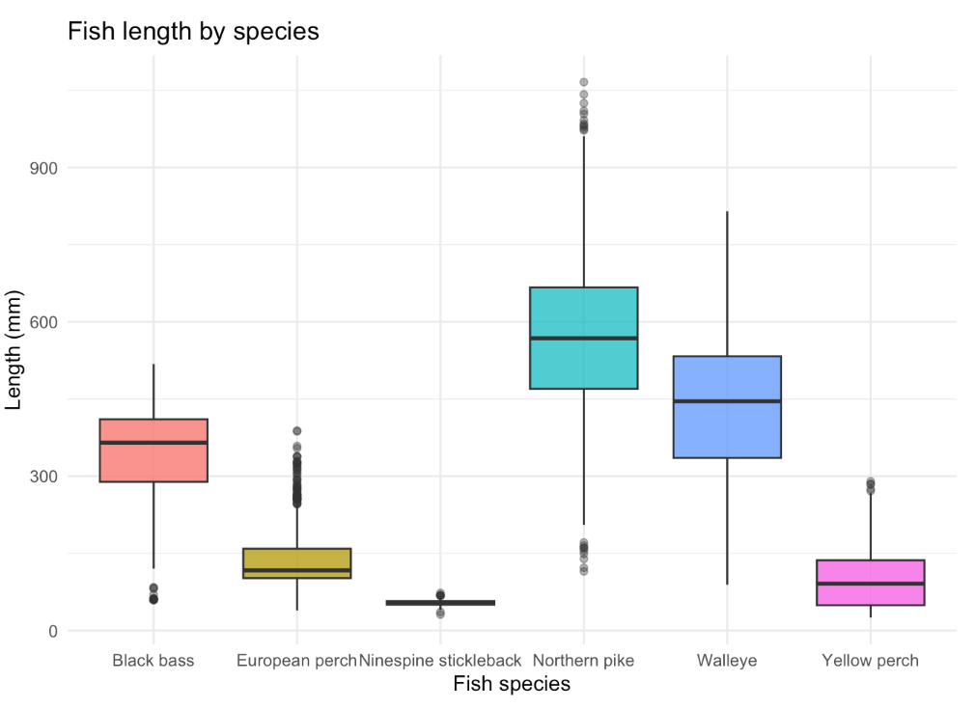
Results

Slide 7
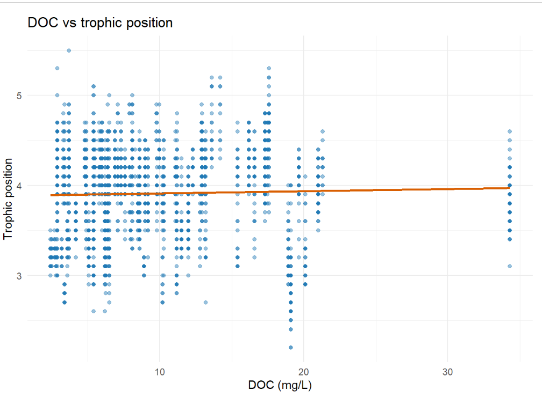
Does DOC relate to trophic position?

Slide 8
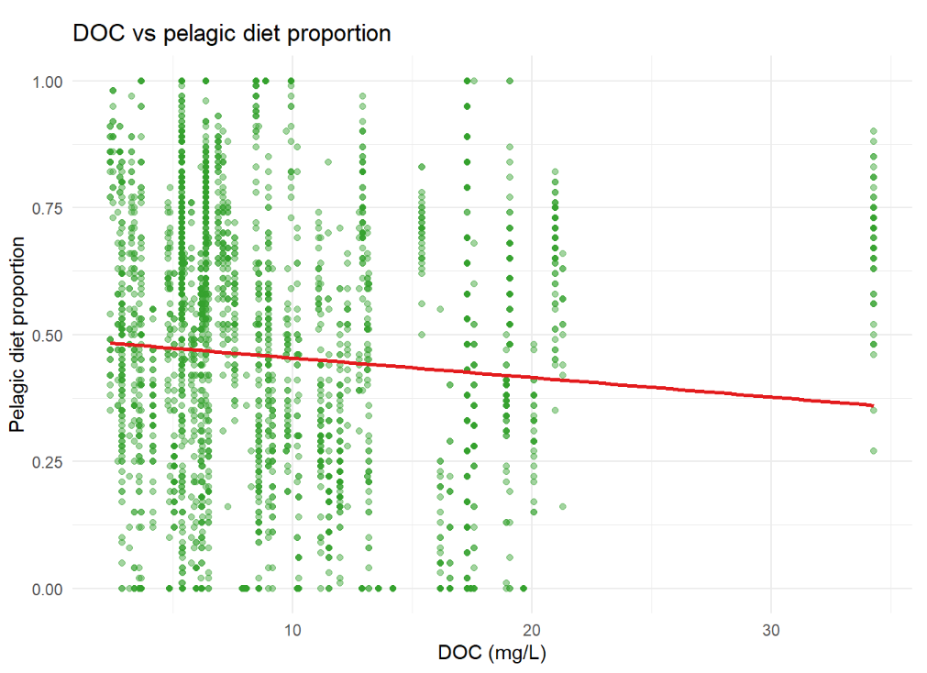
Does DOC relate to pelagic diet proportion?

Slide 9
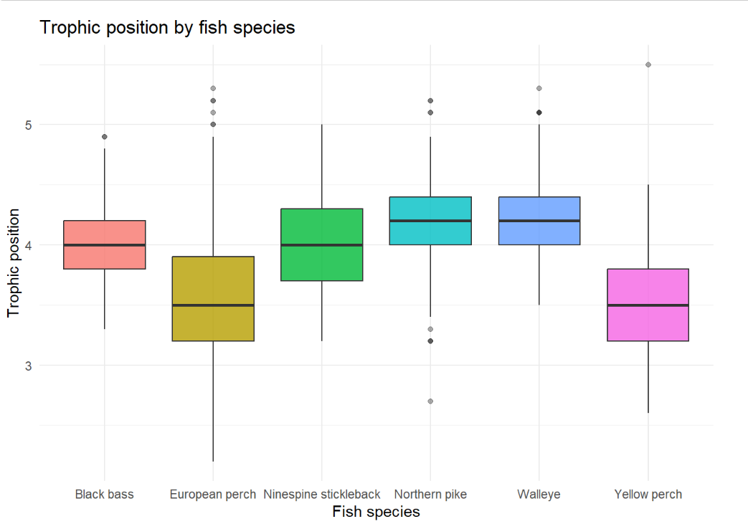
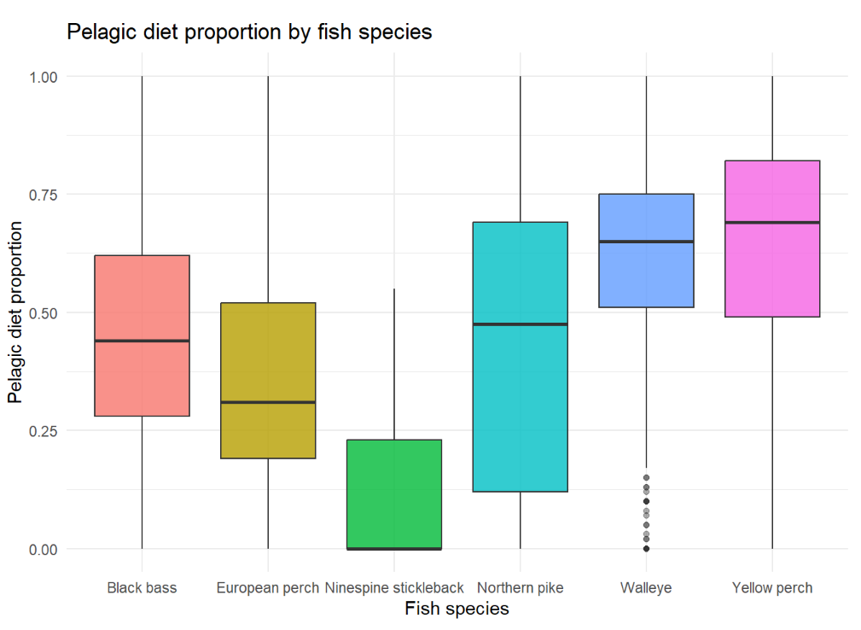
Do DOC patterns vary by species?

Slide 10
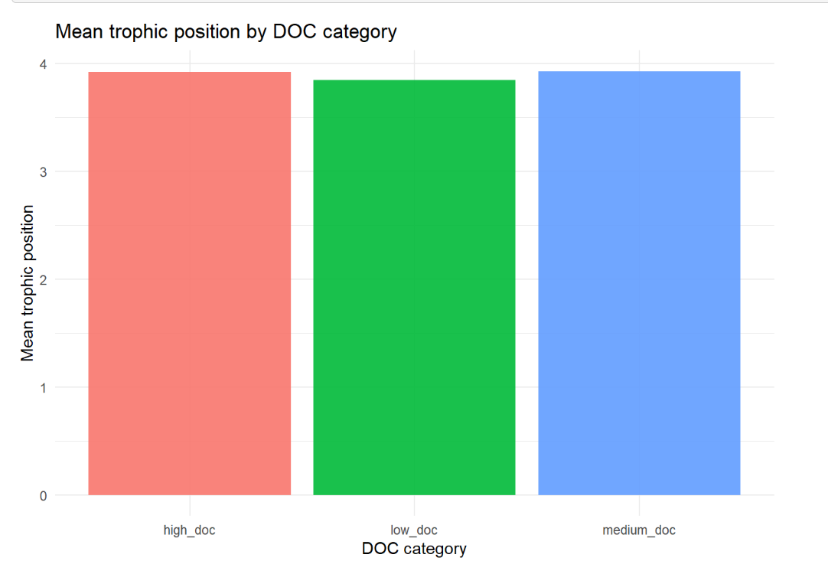
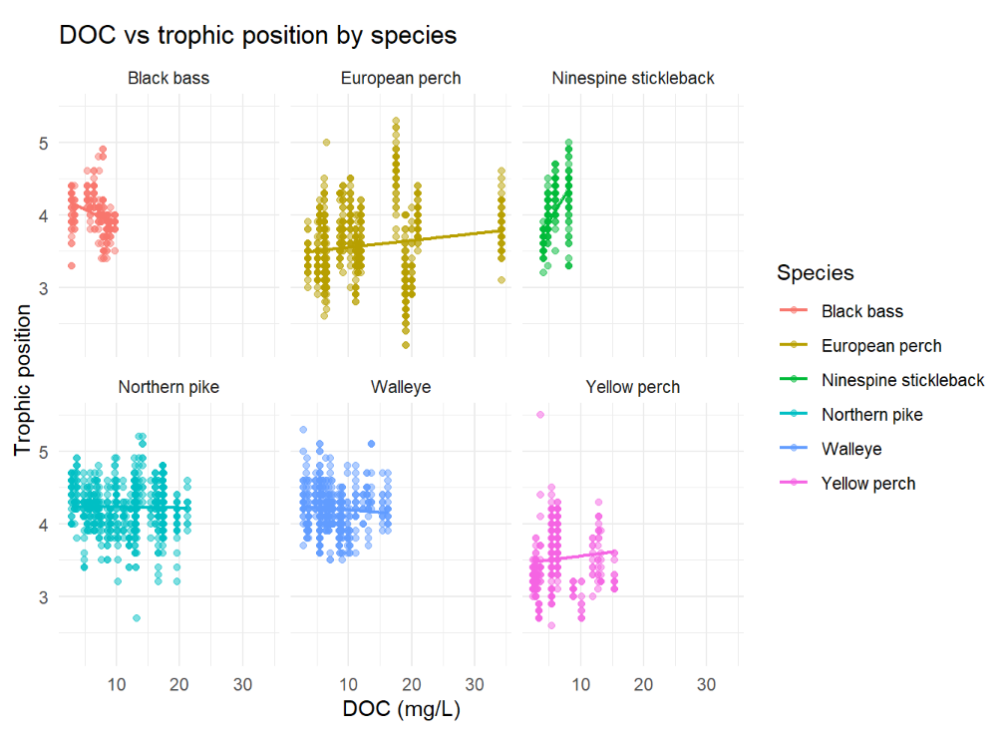
Do DOC patterns vary by species?

Slide 11
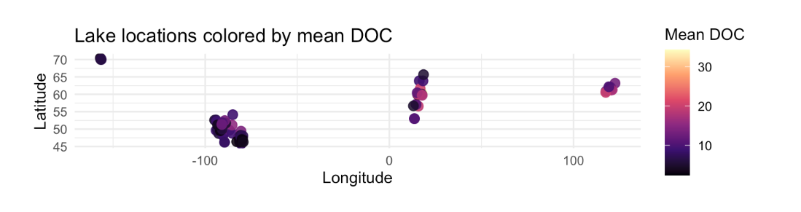
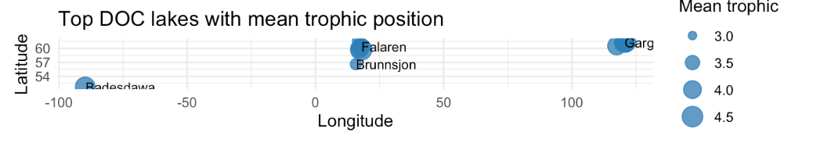
Mapping

Slide 12
Shiny App Demo

Slide 13
Limitations and Conclusion
Overall, trophic position showed only a weak relationship with DOC.
But pelagic diet proportion decreased as DOC increased.
High DOC seem to shift where fish get their food from more than they shift overall food-chain level.
Species differences are also a big reason the full-dataset patterns are not simple.

